Slide 1
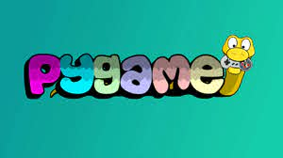

Slide 2
TEAM MEMBERS WORKING ON PROJECT
Vishwa Pratap Singh Chauhan
Pranjal Jain
Prashant Lodhi
Abhishek Chaudhary
Abhishek Tiwari

Slide 3
INTRODUCTION
Flappy bird game is developed in Python and It’s a dektop application. The game was designed and built by Dong Nguyen a developer who lives in vietnam. Flappy bird is a side scroller game where the player controls a bird, attempting the flying between columns of green pipes. The bird will be flying until it collisions with a pipe or it fall on ground. It’s a simple game of infinite level type. It’s a challenging game for all.

Slide 4
From the FAQ
Does not require OpenGL
Uses either opengl, directx, windib, X11, linux frame buer, and many other dierent backends... including an ASCII art backend!
Truly portable
Supports Linux, Windows, Windows CE, BeOS, MacOS, Mac OS X, FreeBSD, NetBSD, OpenBSD, BSD/OS, Solaris, IRIX, and QNX . . .

Slide 5
What each element does: Importing & Initializing
import pygame
to import the Pygame module.
from pygame.locals import *
Optional. Puts limited set of constant and function in the global namespace.
pygame.init()
to initialize Pygame's modules (e.g. pygame.font). Not always needed, but
recommended in any case.

Slide 6
Requirements
A requirement is a singular documented physical or functional need that a particular design, product or process aims to safety. It can be divided into functional requirements and non-functional requirements.

Slide 7
FUNCTIONALITY
Functional-
2D animation, objectives selection, moving wall, collision detection, moving background etc.
Non-Functional –
We can keep the bird playing by pressing mouse, space bar, page up key and move it in the space of pipes.

Slide 8
ANIMATION
2D Animation
Animation is a complex subject in game programming. Animation is rapid display of sequence of images which creates an illusion of movement. Python games are expected to run on multiple operating systems with different hardware specifications.

Slide 9
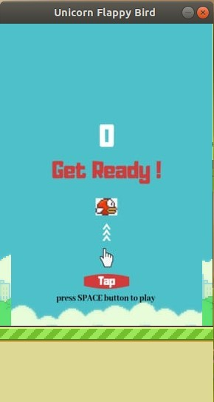
WORKING IMAGES
Figure 1 –
is the start screen of flappy bird. The Welcome screen with message ‘get ready’ is shown on the screen. The bird is also Displayed on the background.

Slide 10
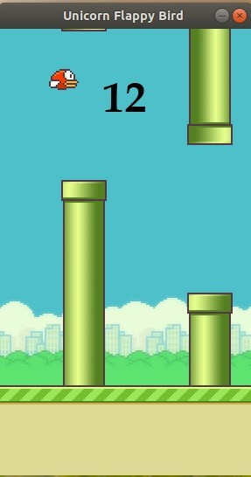
Figure 2 –
shows the screen when the game is on. The 2 pillars are displayed on the screen, and so is the score, on top of the background or the pillar.(instead of title).

Slide 11
Tools
Language: Python
IDE
An IDE ( Integrated Development Environment) contains s code editor, a compiler or interpreter, and a debugger, accessed through a single graphical user interchange (GUI). Our IDE is VS Code ( Visual Studio Code).

Slide 12
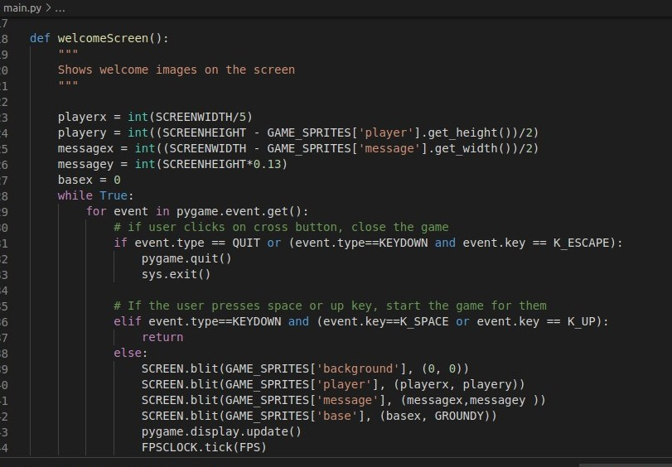
Information
Figure A :
shows welcome images on the screen and checks whether the user wants to play further more or want to quit the game.
Figure A

Slide 13
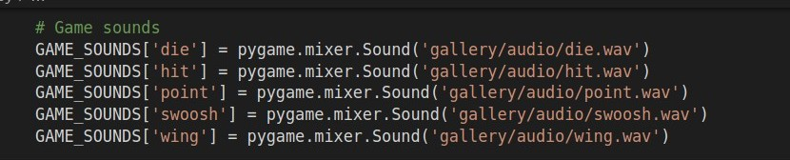
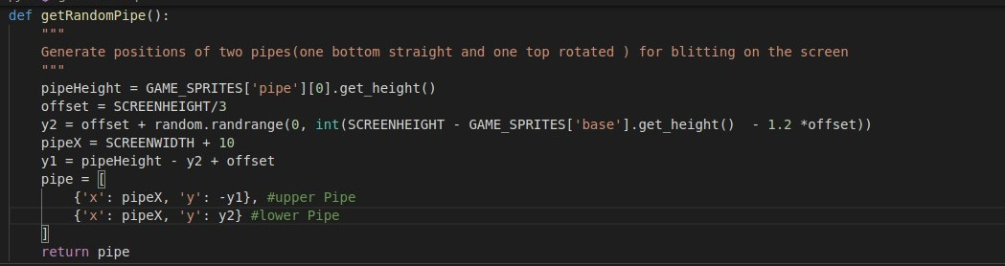
➔ Figure B :
shows the working of the sound handling in our code.
Figure B
➔Figure C :
generates positions of two pipes( one bottom straight and one top
rotated) for blitting on the screen.
Figure C

Slide 14
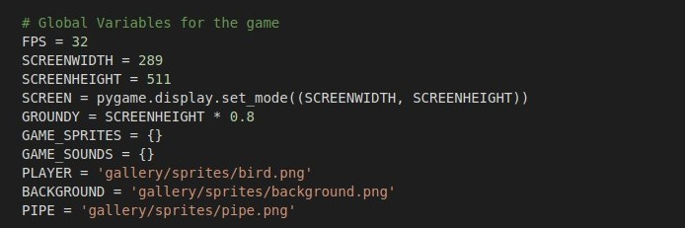

Figure D :
we declares the global variables for the game.
Figure D
Figure E :
shows all the pygame imports needed to run the game.
Figure E

Slide 15
Future Direction
We will add more features to the game and will change the bird and background scenery according to the user’s choice and also trying to make it a multiplayer game. The status and the history will be saved and we show a graph where user can see his total performance whether it increasing or decreasing.

Slide 16
Project Deliverables
Powerpoint microsoft open XML.
Project report
Source code
PDF
References
https://www.pygame.org/news
https://inventwithpython.com/pygame/

Slide 17


